Slide 1


Integrative Bioinformatics Analysis of Breast Cancer: Gene Signatures, Molecular Pathways and Prognostic Insights
By: advikaa sinha
Bioinformatics mini project: June 2026

Slide 2
WHAT IS BREAST CANCER?
Breast cancer is a disease where abnormal cells in the breast grow out of control, forming a mass known as a tumor. These malignant cells can remain contained within the breast (in situ) or invade nearby tissue and spread (metastasize) to lymph nodes or other organs such as the bones, liver, or lungs. It is the most common cancer diagnosed in women and the second most common cause of cancer death among women worldwide, though it can rarely affect men.
The disease typically originates in the milk ducts (ductal carcinoma) or the milk-producing glands (lobular carcinoma). Risk factors include inherited genetic mutations (such as BRCA1 and BRCA2), older age, dense breast tissue, and reproductive history involving prolonged estrogen exposure. Early detection through mammograms and self-exams is critical, as treatment outcomes are significantly better when the cancer is identified before it spreads.

Slide 3
METHODOLOGY
Breast Cancer Selection
↓
Literature Search (PubMed)
↓
Selection of Key Genes
(BRCA1, BRCA2, TP53...)
↓
Biological Pathway Categorization
↓
Protein Interaction Analysis (STRING)
↓
Gene Expression Analysis (GEPIA2)
↓
Survival Analysis (Kaplan-Meier Plotter)
↓
Biological Interpretation
Description:
Breast cancer was selected as the disease of interest.
Relevant genes associated with breast cancer were identified through literature and database searches.
The genes were categorized according to their biological pathways.
Protein-protein interaction analysis was performed to understand gene relationships.
Gene expression patterns were analyzed using public cancer datasets.
Survival analysis was conducted to investigate prognostic significance.
The results were interpreted to understand their role in breast cancer progression.

Slide 4
GENE TABLE
Gene | Symbol | Function | Role in Breast cancer | Biological pathway | Source
BRCA1 DNA Repair Associated | BRCA1 | Repairs DNA and suppresses tumors. | BRCA1 repairs DNA; mutations increase cancer risk. | Homologous recombination repair | GeneCards, PubMed
BRCA2 DNA Repair Associated | BRCA2 | DNA repair and tumor suppression gene. | BRCA2 repairs DNA; mutations raise breast cancer risk | Homologous recombination repair | GeneCards, PubMed
Phosphatase And Tensin Homolog | PTEN | Regulates cell growth and survival. | PTEN suppresses tumors; loss promotes breast cancer | PI3K–AKT pathway inhibition | GeneCards, PubMed
Erb-B2 Receptor Tyrosine Kinase 2 | ERBB2 | Promotes cell growth and division. | ERBB2 overexpression drives aggressive breast cancer | HER2 signaling pathway | GeneCards, PubMed
Estrogen Receptor 1 | ESR1 | Mediates estrogen signaling and transcription. | ESR1 drives estrogen-dependent breast cancer growth | Estrogen receptor signaling | GeneCards, PubMed
Tumor Protein P53 | TP53 | Controls cell cycle and apoptosis. | TP53 mutations drive aggressive breast cancer | DNA damage response | GeneCards, PubMed
Phosphatidylinositol-4,5-Bisphosphate 3-Kinase Catalytic Subunit Alpha | PIK3CA | Activates cell growth and survival | PIK3CA mutations drive breast cancer growth | PI3K–AKT signaling | GeneCards, PubMed
Checkpoint Kinase 2 | CHEK2 | Triggers DNA damage checkpoint response. | CHEK2 mutations increase breast cancer risk | DNA damage checkpoint | GeneCards, PubMed
AKT Serine/Threonine Kinase 1 | AKT1 | Promotes cell survival and growth. | AKT1 mutations promote breast cancer growth | PI3K–AKT signaling | GeneCards, PubMed
Cyclin Dependent Kinase Inhibitor 2A | CDKN2A | Inhibits cell cycle progression. | Loss promotes uncontrolled breast cancer cell growth. | Cell cycle regulation | GeneCards, PubMed

Slide 5
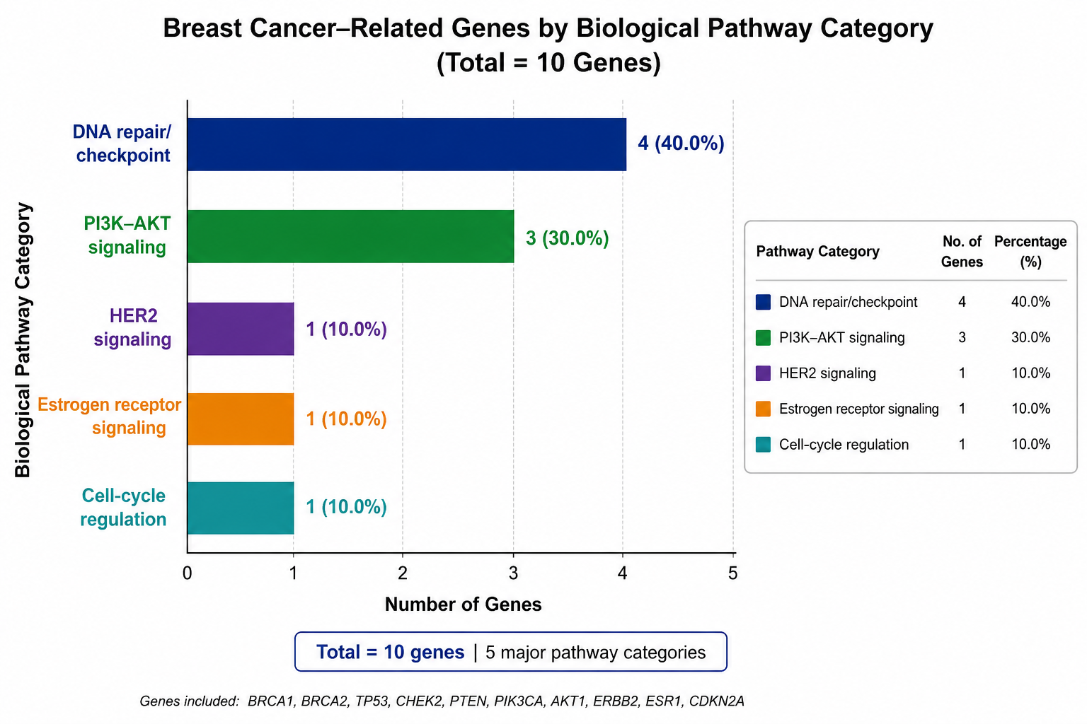
CHART
Pathway category | Genes | Count
DNA repair/checkpoint | BRCA1, BRCA2, TP53, CHEK2 | 4
PI3K–AKT signaling | PTEN, PIK3CA, AKT1 | 3
HER2 signaling | ERBB2 | 1
Estrogen receptor signaling | ESR1 | 1
Cell-cycle regulation | CDKN2A | 1

Slide 6

PROTEIN INTERACTION NETWORK STRING analysis revealed strong interactions among TP53, BRCA1, BRCA2 and PTEN, indicating their central role in maintaining genomic stability. The protein interaction network revealed strong connectivity among the selected genes, indicating that breast cancer results from disruptions in multiple interconnected biological processes rather than a single gene defect.

Slide 7
GENE EXPRESSION ANALYSIS Expression profiles of TP53, ERBB2, and ESR1 were compared between tumor and normal breast tissues. TP53 | ERBB2 | ESR1 (three enlarged plots) Legend: 🟥 Tumor | 🟦 Normal Key finding: Significant differential expression was observed between tumor and normal tissues (*p < 0.05). TP53 Altered TP53 expression indicates disruption of normal cell-cycle control and DNA damage response mechanisms in breast cancer. ERBB2 ERBB2 showed higher expression in breast cancer tissues compared to normal tissues, suggesting its role in promoting tumor growth and progression. ESR1 ESR1 expression was observed in breast cancer samples, highlighting the importance of estrogen signaling in hormone-responsive breast cancer.

Slide 8
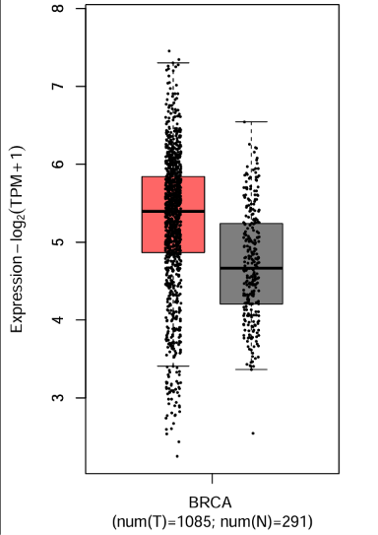
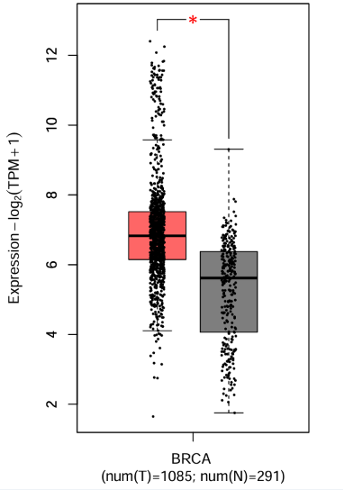
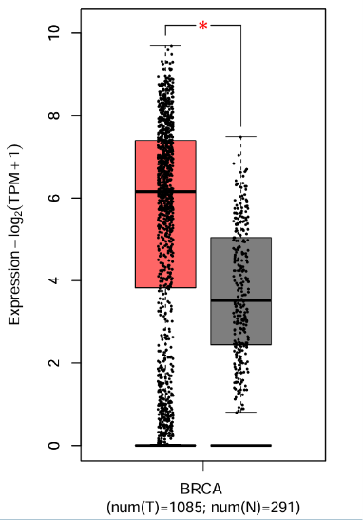
TP53
ERBB2
ESR1

Slide 9
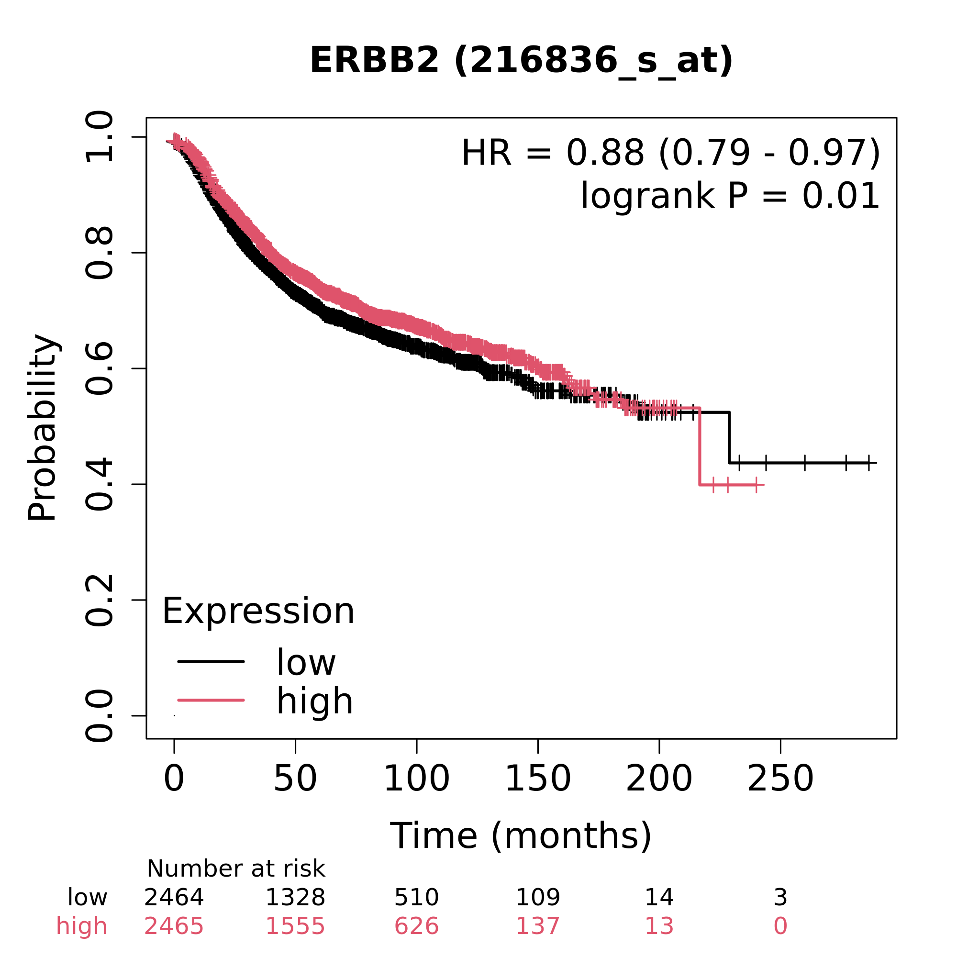
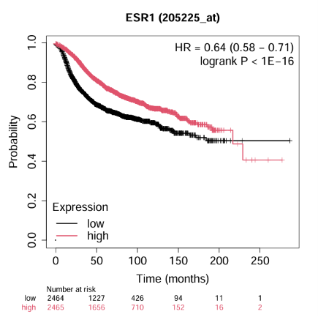
SURVIVAL ANALYSIS Kaplan–Meier survival analysis revealed that high ERBB2 expression was significantly associated with improved relapse-free survival in breast cancer patients (HR = 0.88, 95% CI: 0.79–0.97, log-rank P = 0.01). High ESR1 expression was significantly associated with improved relapse-free survival in breast cancer patients (HR = 0.64, 95% CI: 0.58–0.71, P < 0.001).

Slide 10
MOLECULAR PATHWAY(KEGG)
KEGG pathway analysis demonstrated the involvement of breast cancer-associated genes in the PI3K-AKT signaling pathway, one of the most frequently altered pathways in human cancers. Genes such as PIK3CA, AKT1, and PTEN function as key regulators of cellular growth and survival signaling. Activation of PI3K leads to downstream activation of AKT, which promotes cell proliferation and inhibits programmed cell death. Conversely, PTEN acts as a negative regulator of this pathway and prevents excessive signaling. Genetic alterations affecting these components may disrupt normal cellular regulation, resulting in enhanced tumor growth, survival of malignant cells, and disease progression. These findings highlight the biological significance of the PI3K-AKT pathway as a potential therapeutic target in breast cancer.

Slide 11
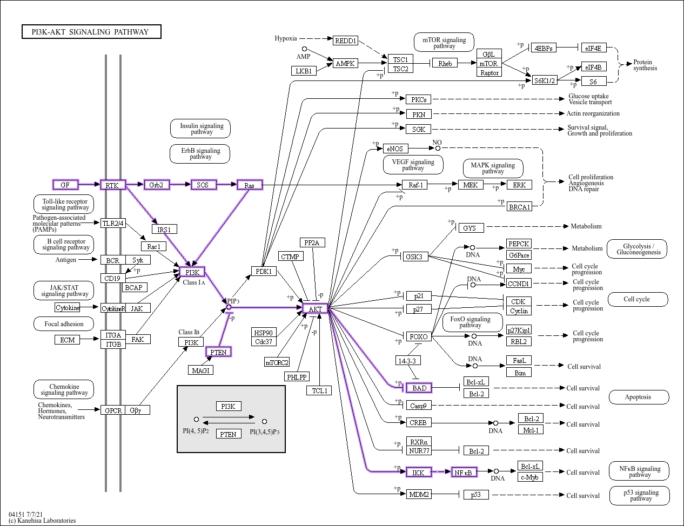

Slide 12
KEY FINDINGS
✅ Breast cancer is a multi-pathway disease.
✅ DNA repair genes (BRCA1, BRCA2, TP53, CHEK2) are critical for genomic stability.
✅ PI3K-AKT signaling plays a central role in tumor growth and survival.
✅ Protein interaction analysis revealed highly interconnected gene networks.
✅ ERBB2, ESR1, and TP53 showed potential clinical and prognostic significance.
✅ Both tumor suppressor genes and oncogenes contribute to breast cancer progression.

Slide 13
TOOLS USED AND REFERENCES
Tool | Purpose
PubMed | Literature search
GeneCards | Gene information
STRING | Protein interaction
GEPIA2 | Gene expression
Kaplan-Meier Plotter | Survival analysis
KEGG | Pathway analysis
References
PubMed
GeneCards
STRING
GEPIA2
Kaplan-Meier Plotter
KEGG

